Slide 1
Final Project – DSC530
Kalaivani Kalyanasundaram

Slide 2
Dataset
This is a heights data frame that includes factors affecting height.
Key variables: height, earn, sex, ed, and age

Slide 3
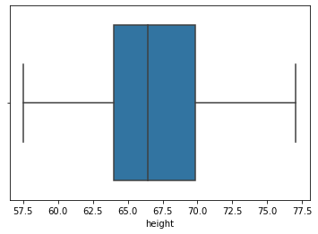
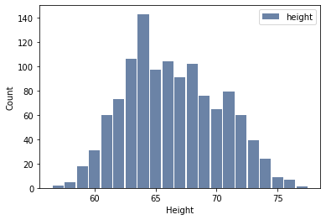
Height
This variable represents the height of individuals.
Roughly symmetric with no apparent outliers
Mean: 66.91515376107574 Median: 66.4512652109843 Mode: 74.4244387818035

Slide 4
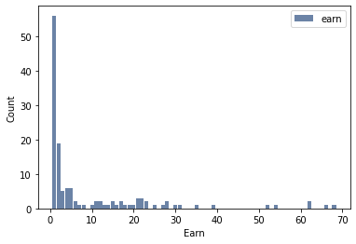
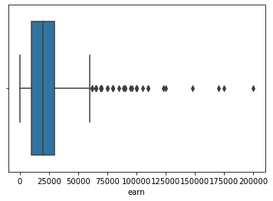
Earn
This variable represents the earning of individuals.
Skewed right with many outliers
Mean: 23154.773489932886 Median: 20000.0 Mode: 15000.0

Slide 5
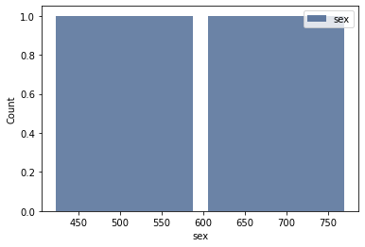
Sex
This variable represents the sex of individuals.
Bimodal with no outliers and descriptive statistics as it is a string

Slide 6
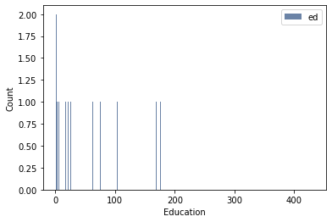
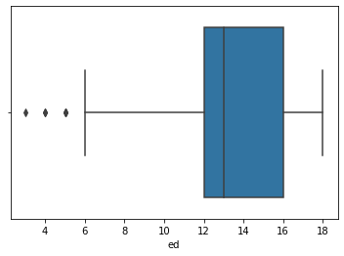
Ed
This variable represents the education level of individuals.
Skewed right with a few outliers
Mean: 13.504194630872483 Median: 13.0 Mode: 12

Slide 7
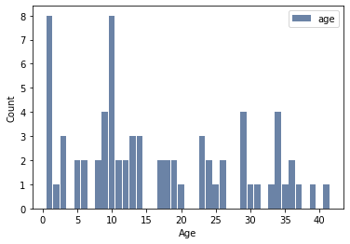
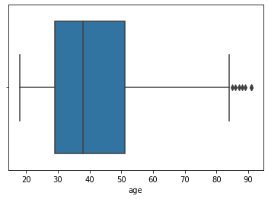
Age
This variable represents the age of individuals.
Skewed right with a many outliers
Mean: 41.37835570469799 Median: 38.0 Mode: 32

Slide 8
Height PMF

